Slide 1
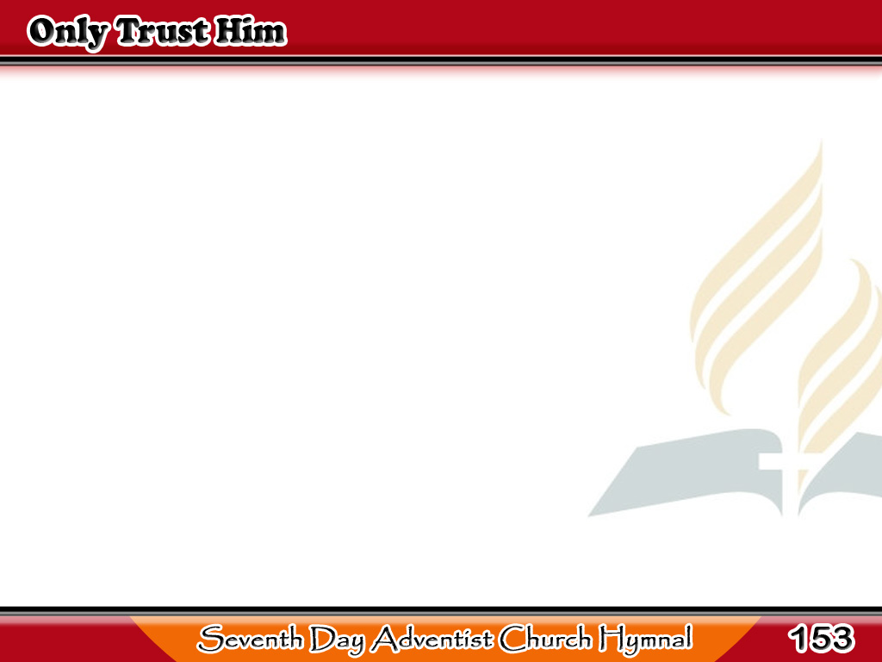
Kaluluwang Tigib Sala
Come, every soul
by sin oppressed,
There’s mercy with the Lord,
And He will surely give you rest,
By trusting in His word.
1/4

Slide 2
Kaluluwang Tigib Sala
-Refrain-
Only trust Him, only trust Him,
Only trust Him now;
He will save you, He will save you,
He will save you now.
1/4

Slide 3
Kaluluwang Tigib Sala
For Jesus shed His precious blood
Rich blessings to bestow;
Plunge now into the crimson flood
That washes white as snow.
2/4

Slide 4
Kaluluwang Tigib Sala
-Refrain-
Only trust Him, only trust Him,
Only trust Him now;
He will save you, He will save you,
He will save you now.
2/4

Slide 5
Kaluluwang Tigib Sala
Yes, Jesus is the truth, the way,
That leads you into rest;
Believe in Him without delay,
And you are fully blest.
3/4

Slide 6
Kaluluwang Tigib Sala
-Refrain-
Only trust Him, only trust Him,
Only trust Him now;
He will save you, He will save you,
He will save you now.
3/4

Slide 7
Kaluluwang Tigib Sala
Come, then, and join
this holy band,
And on to glory go;
To dwell in that celestial land,
Where joys immortal flow.
4/4

Slide 8
Kaluluwang Tigib Sala
-Refrain-
Only trust Him, only trust Him,
Only trust Him now;
He will save you, He will save you,
He will save you now.
4/4

